Slide 1


EVOLUTIONARY AUTOML
MOAD HANI
YANN HOFFMANN
THI HUYEN TRANG HOANG
DR. EMMANUEL KIEFFER
DR. BOONYARIT CHANGAIVAL
27/03/2020

Slide 2
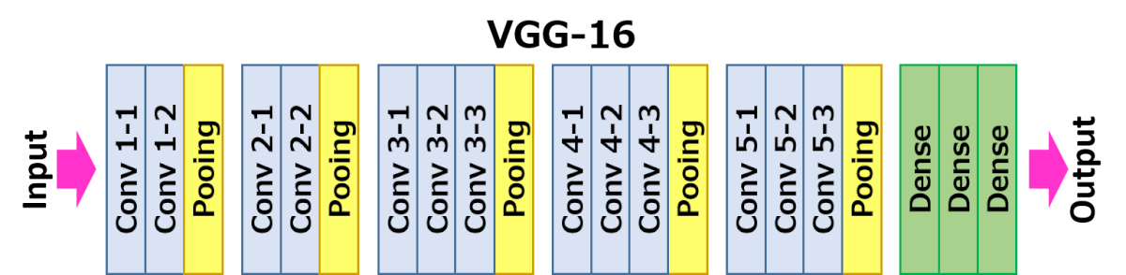
1. CONTEXTUALIZATION
Context
Data, computing power and algorithms are fueling Machine Learning (ML)
Logical Follow-Up: Deep Learning (DL)
Motivation
Convolutional Neural Networks (CNN)
CNN’s are chiefly designed manually
Finding a new CNN involves a lot of time, effort and luck
Objective
Finding an internal structure for a subset of Neural Networks (NN)
Garner insights into CNN
Automated Architecture
DIY NN
Notes:
Essential: the Holy Grail of ML

Slide 3

What’s happening inside the ConvNets ? The answer: Convolution / matrix multiplication.
One of the most popular algorithms for DL, in which a model learns to perform
classification tasks directly from images, video, text, or sound.
2. Convolutional neural networks
3D Convolution Animation — Author: Michael Plotke

Slide 4
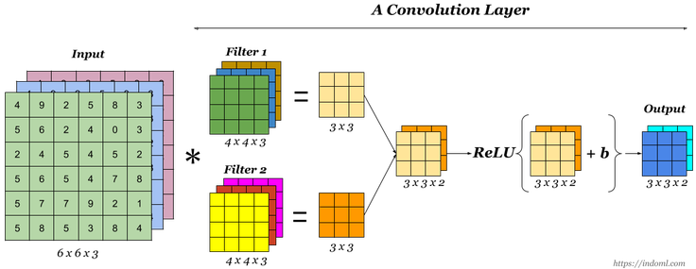
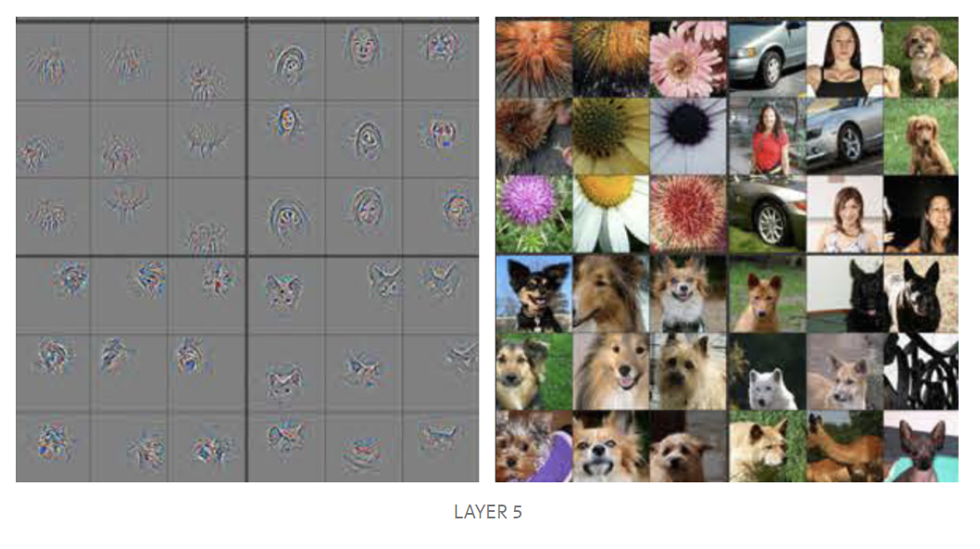
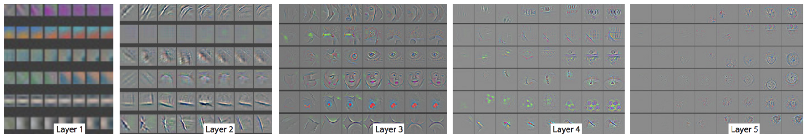
3. CNN – Convolution Layer
Finally to make up a convolution layer, a bias (ϵ R) is added and an activation function such as ReLU is applied.

Slide 5

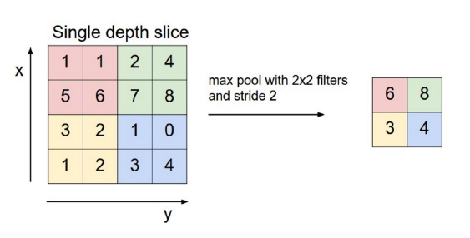
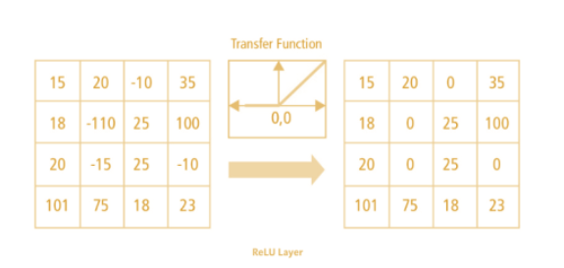
3. CNN : Key-concepts
1. Padding and Stride:
2. Pooling:
3. Non Linearity (ReLU):
ReLU stands for Rectified Linear Unit for a non-linear operation. The output is ƒ(x) = max(0,x). Since, the real world data would want our ConvNet to learn would be non-negative linear values.

Slide 6
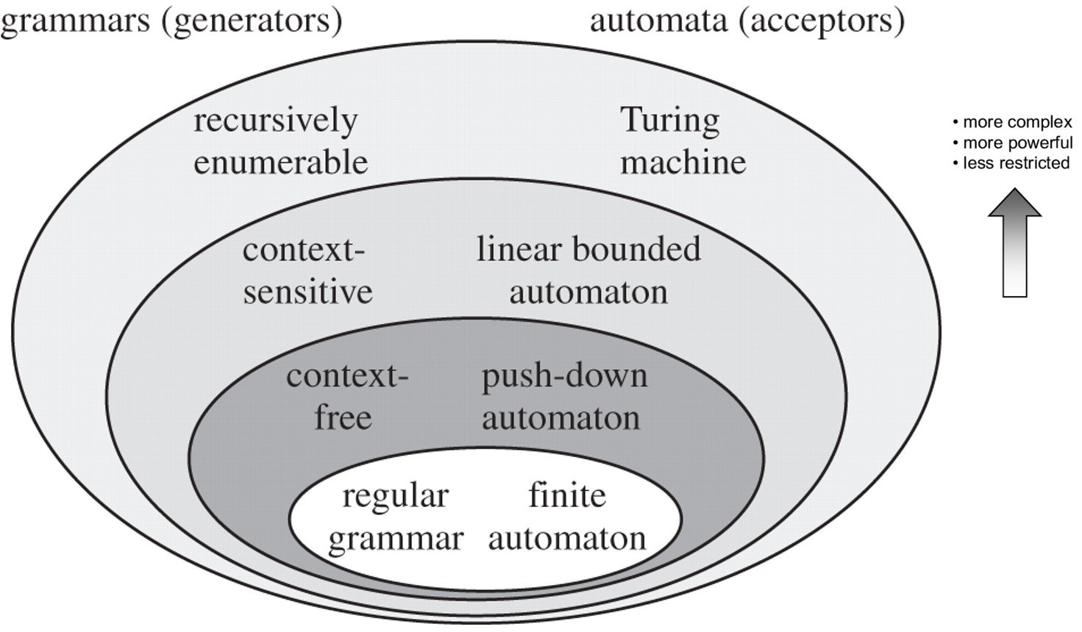
4. MODEL
Type 2 - Grammar Model
Variables
Non-terminal symbols
Instantiation of the GE algorithm
Objective function: Validation of training CNNs
Constraints: Production rules
Notes:
Additionally

Slide 7
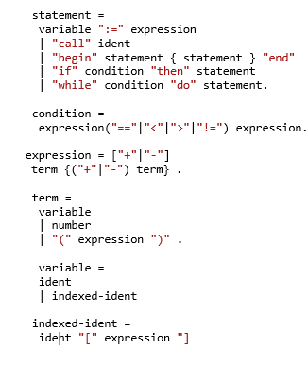
4.1. CONTEXT-FREE GRAMMAR
BNF: Standard notation
A collection of {N,T,P,S}
S: START SYMBOLS
P: PRODUCTION RULES
N: NON-TERMINAL SYMBOLS
T: TERMINAL SYMBOLS
Notes:
Chomsky
It lies between bounded

Slide 8
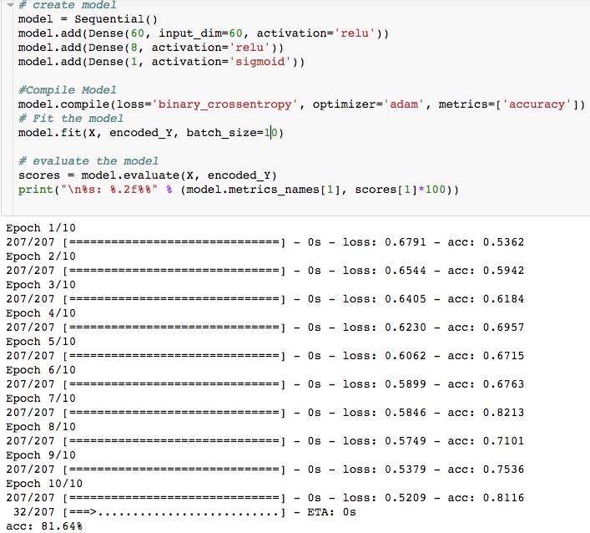
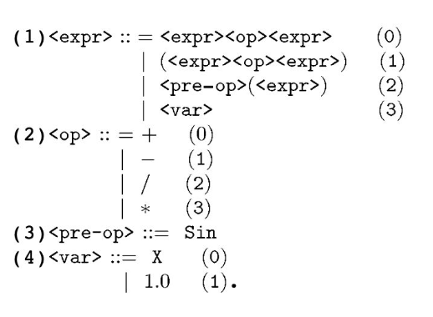

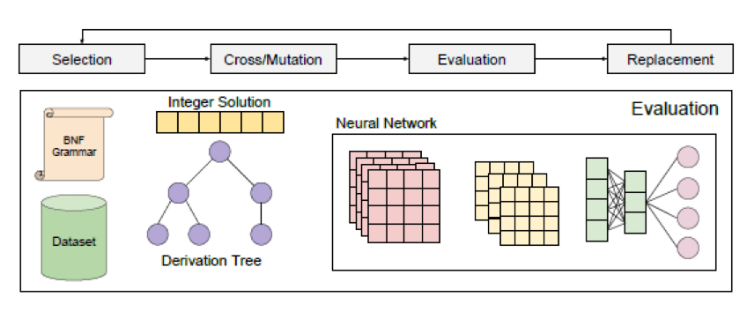
5. GRAMMAR EVOLUTION
Genotype
Phenotype
Notes:
This IS the optimization step
“mapping process”

Slide 9
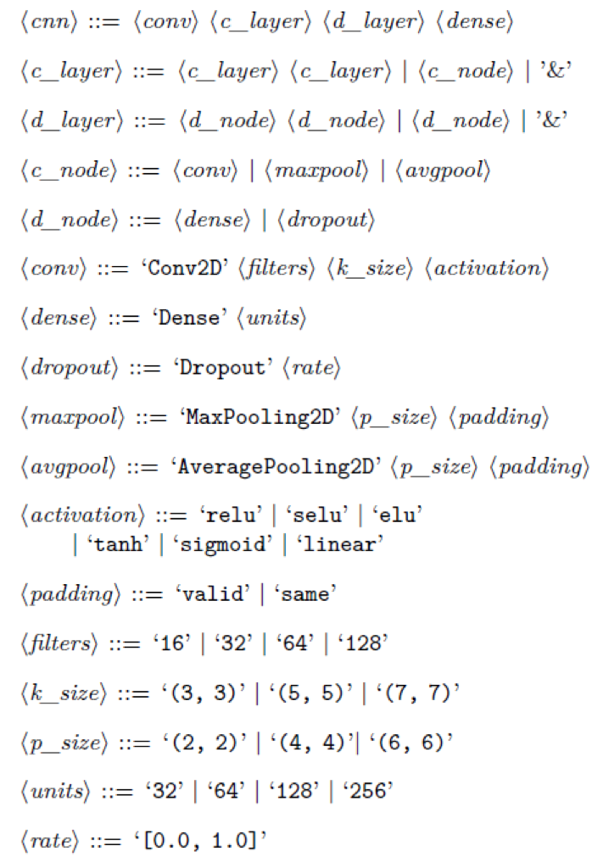
6. GRAMMAR FOR CNN
An example of grammar to generate CNN architectures
Number of convolutional layers
Number of dense layers
Parameters of convolutional layer
Parameters of dense layer
Reference: Lima, Ricardo HR, and Aurora TR Pozo.
"Evolving convolutional neural networks through grammatical evolution." 2019.

Slide 10
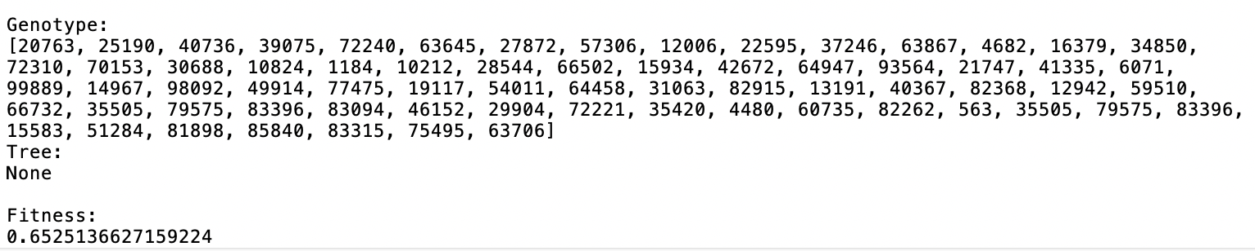
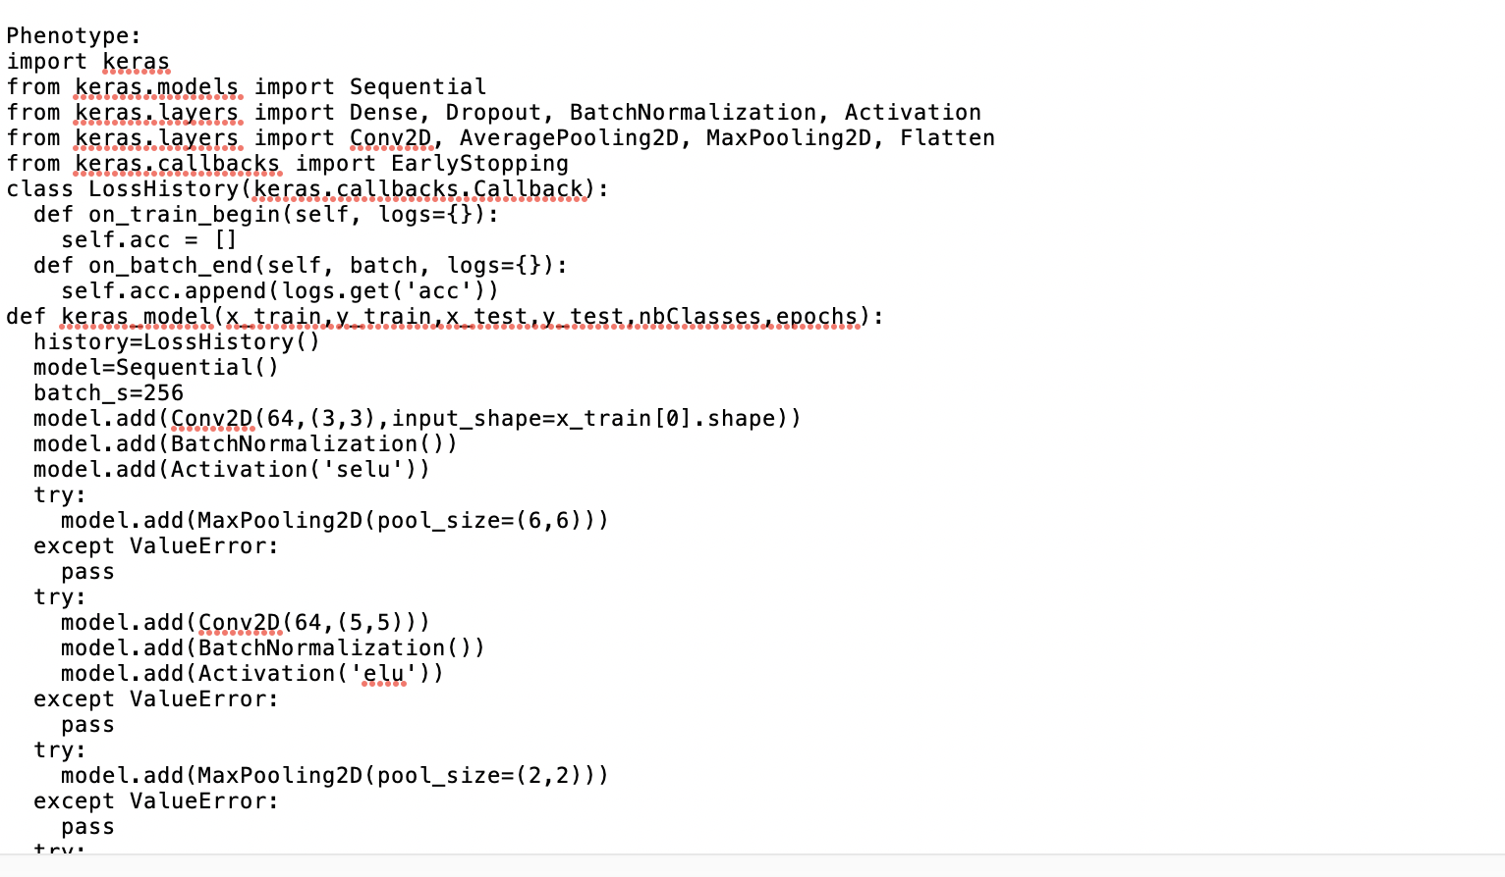

Slide 11
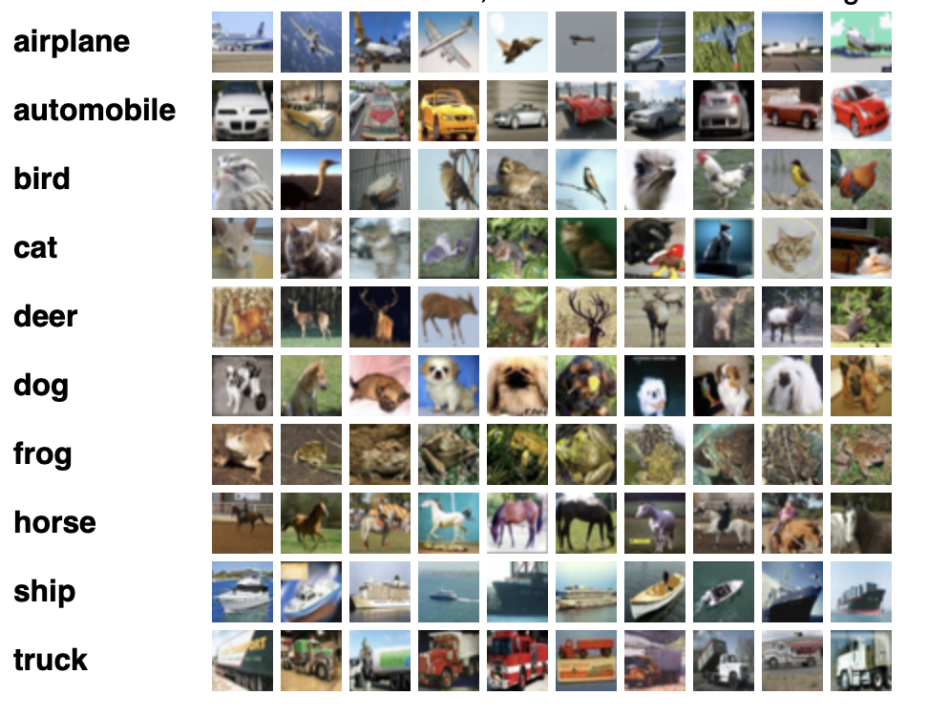
7. CIFAR-10 DATASET
60,000 (32x32) color10 classes, with 6000 images per class.
50,000 training images and 10,000 test images.
http://www.cs.toronto.edu/~kriz/cifar.html
Notes:
small subset of CIFAR

Slide 12
8. NEXT STEPS
Design a suitable grammar
Evolve CNN architectures with GE
Support library: PonyGE2 (implementation for GE in Python)
Dataset: CIFAR-10
Run on HPC
Compare the result with other state-of-the-art approaches.
Eg: VGG, ResNet, CGP-CNN (ConvSet), CGP-CNN (ResSet)

Slide 13

Questions are welcome!
Photo credit: HypnoArt via Pixabay
(Creative Commons Zero license)
Notes:
© Copyright Showeet.com – Free PowerPoint Templates

